Slide 1

Gradient Computation

Slide 2
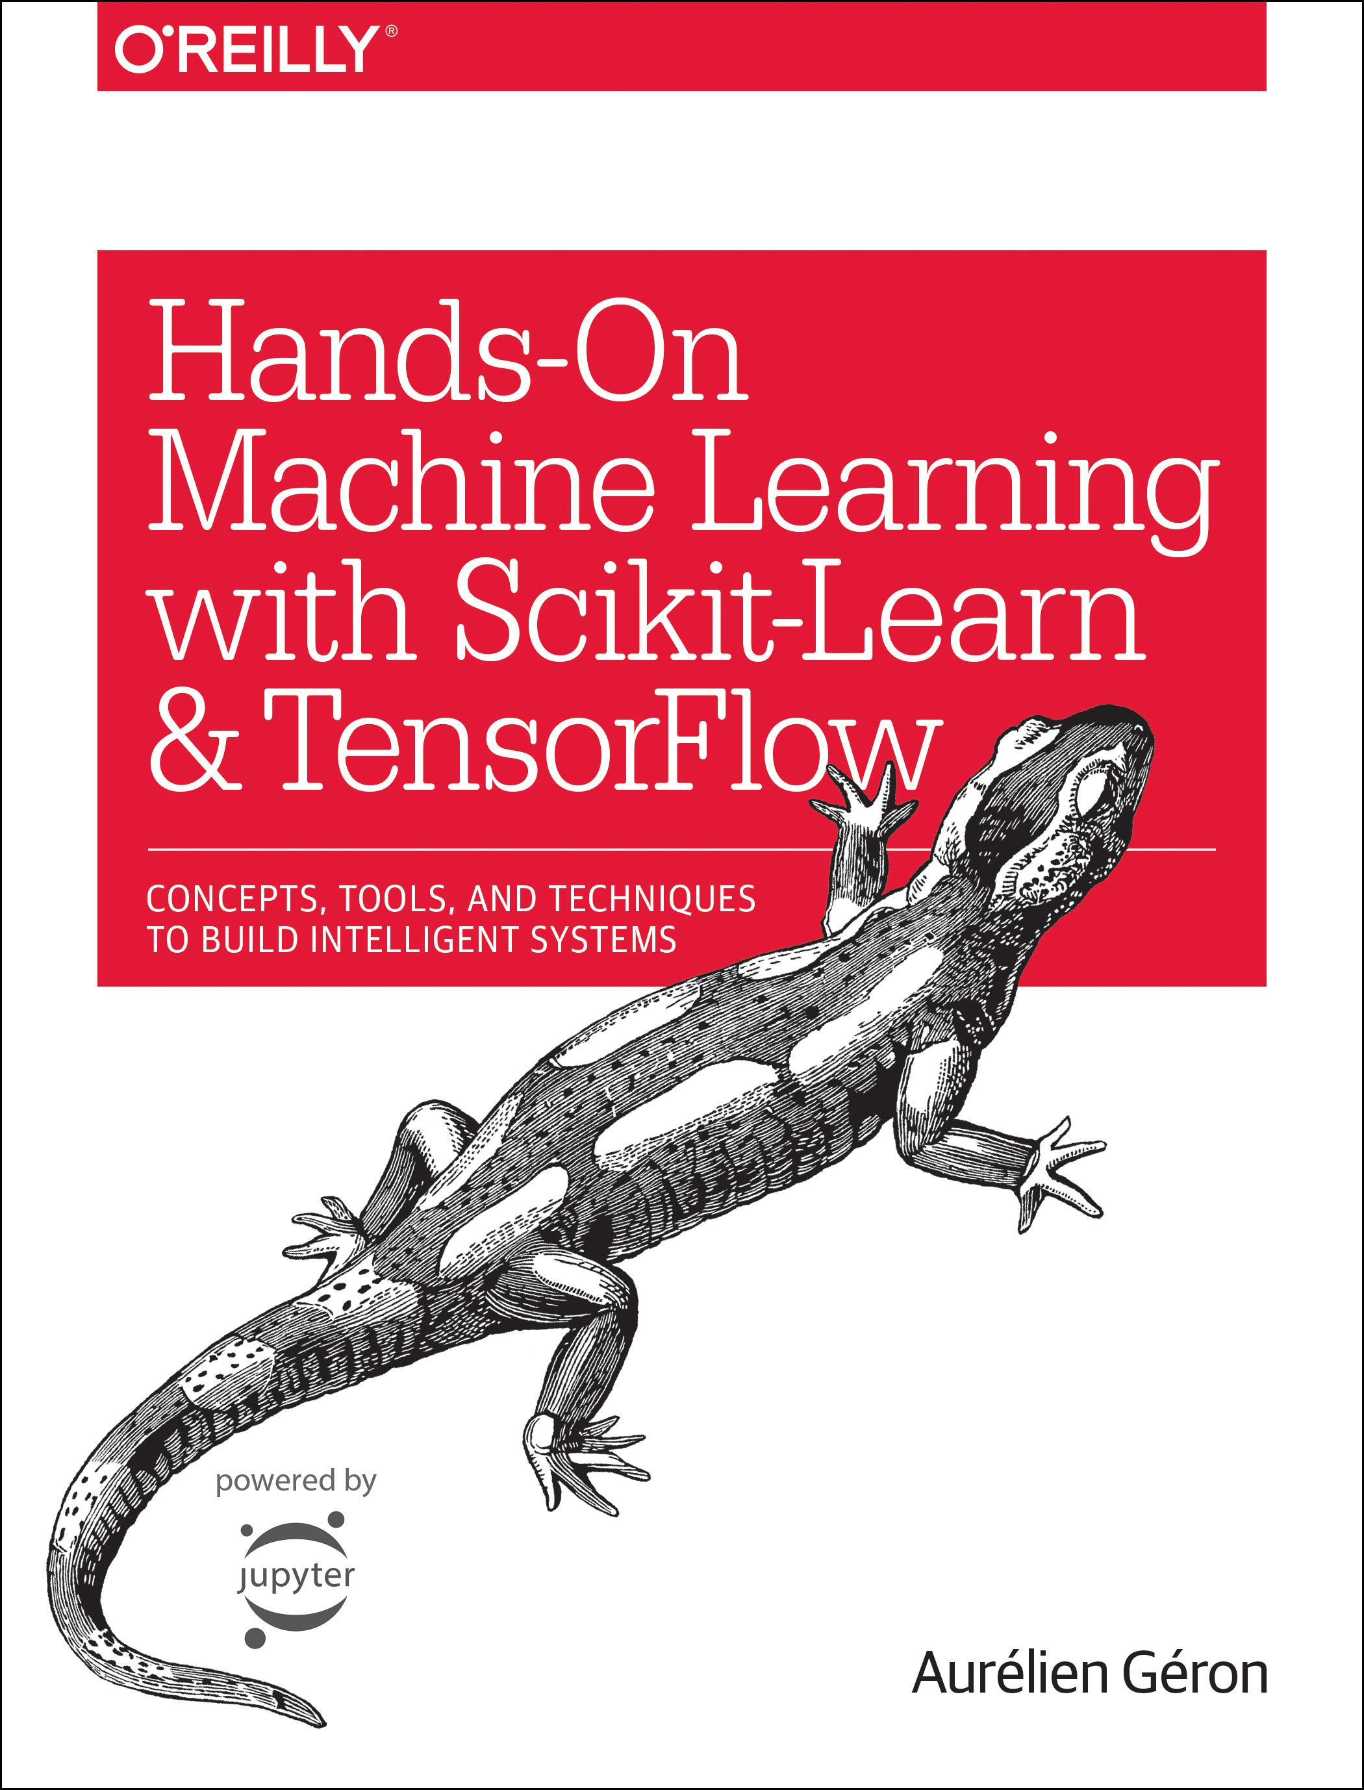
Reference
Chapter 9 (O'Reilly) of Hands-On ML
Youtube
Code

Slide 3
Manual Gradient Computation

Slide 4
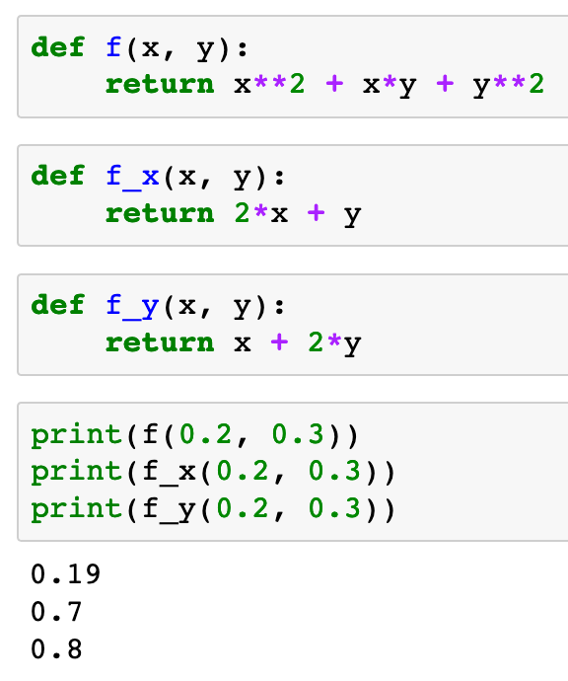

Slide 5
Warm Up

Slide 6
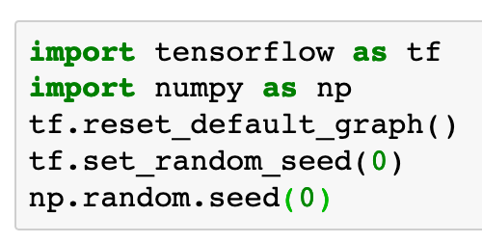

Slide 7
Tensorflow Gradient Computation

Slide 8
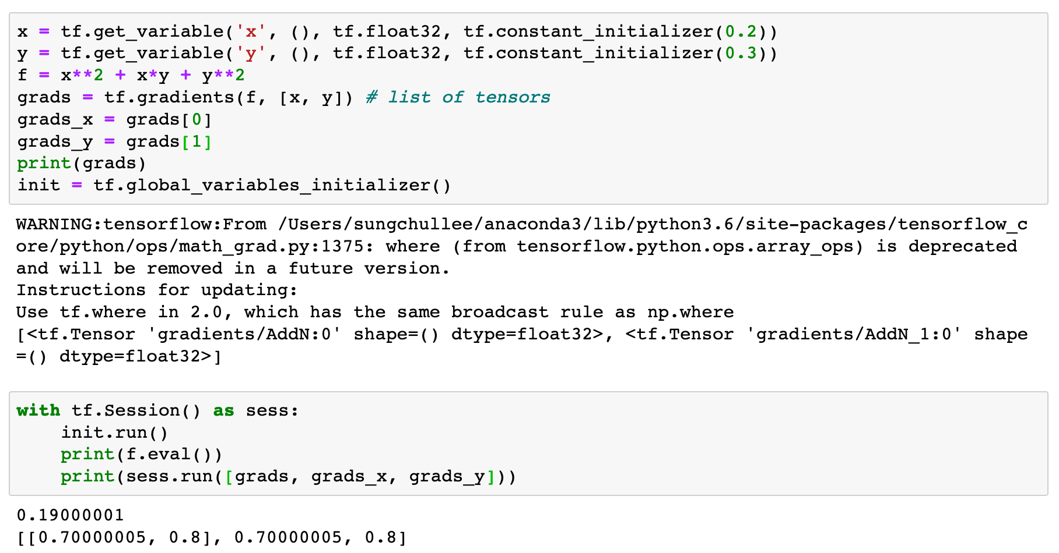


Slide 9
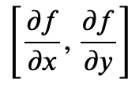

Slide 10


Slide 11


Slide 14
Now
Let’s Play with Code

